Slide 1
Physical Electronics lecture-1
Energy Levels and Atomic Structure
Dr. Suha I. Al- Nassar

Slide 2
Energy Levels and Atomic Structure The atom : The atom is a basic unit of matter that consists of a dense central nucleus surrounded by a cloud of negatively charged electrons. The atomic nucleus contains a mix of positively charged protons and electrically neutral neutrons The atomic weight : The mass of a given atom, measured on a scale in which the hydrogen atom has the weight of one. Because most of the mass in an atom is in the nucleus, and each proton and neutron has an atomic weight near one, i.e it is a ratio between the weight (mass) of atom in the matter to the weight of hydrogen atom. W=m / w_{H} Where W:atomic weight m: weight of atomic in the matter w_{H}: weight of hydrogen atom Note: atomic weight of H-atom = 1.008 The atomic number : It is a number of protons in the nucleus of an atom. In electrically neutral atoms, this number is also equal to the number of electrons orbiting about the atom's nucleus. and is usually denoted by the letter Z and written as a subscript before an element's symbol, as in ₉₂ U. Avogadro's number : It is indicating the number of atoms or molecules in a mole of any substance , and its value is equal to 6.023 ×10²³ mol⁻¹ . N_{A}= n / m Where N_{A}= Avogadro's number n= No. of molecular m= No. of moles

Slide 3
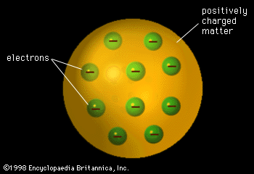
Models of atoms 1-Thomson's Model
And he calculated the charge of electrons (1.6*10 ⁻¹⁹) coulomb and it's mass =(9.1 *10⁻³¹ kg).

Slide 4
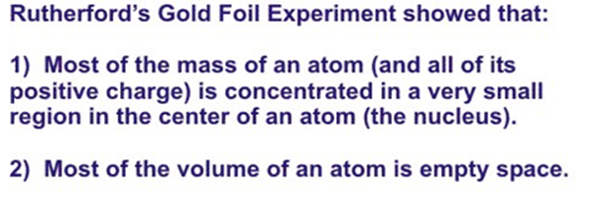
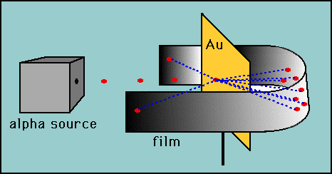
2-Rutherford's Model
The strengths and weaknesses of Rutherford's atomic model:
strengths: -electrons move fast through the atom. -electrons are trapped within the atom by a positively charged nucleus -electrons are negatively charged.
weaknesses: -failed to discover the nucleus contains positively charged particles called protons -failed to discover the nucleus also contains neutrons (a sub atomic neutral part).

Slide 5
3-Bohr's Model:
The planetary model of Rutherford did not solve the problem completely, since electrons moving around the nucleus in an orbit were expected to lose energy, and thus eventually would spiral into the nucleus.
Bohr observed that when hydrogen is heated, only a few precise wavelengths of light are emitted. The spectrum produced when this light is passed through a prism is call the LINE or EMISSION SEPECTRUM.
When a Hydrogen atom is excited, the electron gains (absorbs) a certain quantity of energy and jumps from a lower a allowed energy level to a higher allowed energy level. The quantity of energy required for this promotion equals the difference in energy between the 2 energy levels.
When an electron drops back to a lower energy level l, the previously gained energy is given off in the form of radiation of a definite frequency. The frequency of the radiation depends on the amount of energy emitted (and can be calculated using the equation E = hv).

Slide 6
Bohr's postulates
Electrons revolve around the nucleus in circular path, which are known as "ORBITS" or "ENERGY LEVEL, this motion of an electron to be under the influence of the Coulomb attraction between the electron and the nucleus, obeying the laws of classical mechanics.
the Energy of an electron in one of its allowed orbits is fixed. As long as an electron remains in one of its allowed orbit, it cannot absorb or radiate energy .
. Energy released or absorbed by an electron is equal to the difference of energy of two energy levels.
∆ E = E₂ - E₁
The angular momentum of an electron is given by:
Instead of the infinity of orbits which would be possible in classical mechanics, it is only possible for an electron to move in an orbit for which its orbital angular momentum L is and integral multiple of .
Despite the fact that it is constantly accelerating, an electron moving in such an allowed orbit does not radiate electromagnetic energy. Thus, its total energy E.

Slide 7
Limitations of Bohr Model
electron couldn’t circle around nucleus like a planet! Because they would lose energy (by emitting electromagnetic radiation) & spiral into nucleus.
The Bohr Model can only explain the line spectrum of hydrogen (an atom with only one electron) adequately
Scientists eventually concluded that Bohr’s model did not fully describe the fine structure of an atom
It can't explain molecular bonds.
Instead of the infinity of orbits which would be possible in classical mechanics, it is only possible for an electron to move in an orbit for which its orbital angular momentum L is and integral multiple of .
Despite the fact that it is constantly accelerating, an electron moving in such an allowed orbit does not radiate electromagnetic energy. Thus, its total energy E.

Slide 8
Rydberg formula for any hydrogen-like element
is the wavelength of the light emitted in vacuum
n₁ | n₂ | Name | Converge toward
1 | 2 → ∞ | Lyman series | 91.13 nm (UV)
2 | 3 → ∞ | Balmer series | 364.51 nm (Visible)
3 | 4 → ∞ | Paschen series | 820.14 nm (IR)
4 | 5 → ∞ | Brackett series | 1458.03 nm (Far IR)
5 | 6 → ∞ | Pfund series | 2278.17 nm (Far IR)
is the Rydberg constant for this element
is the atomic number
And
are integers

